Slide 1
Structured Outputs with Finite State Machines
Controlling LLM Output for Reliable Applications

Slide 2
The Problem: Unstructured LLM Output
Large language models (LLMs) excel at generating human-like text, but their output is inherently probabilistic and often unstructured.
This makes it difficult to:
Reliably integrate LLMs into software applications.
Guarantee the output adheres to a desired format (e.g., JSON, XML, code).

Slide 3

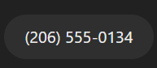
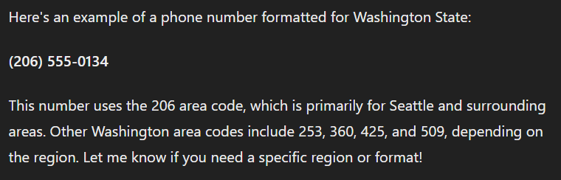

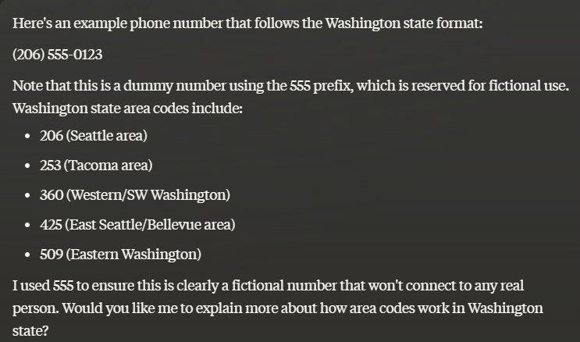
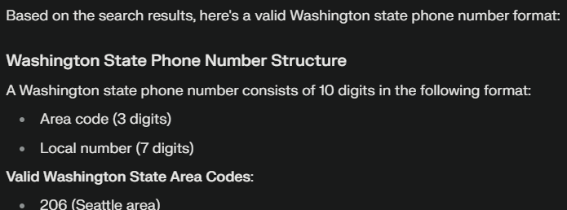
Example: Unstructured LLM Output
What you want
What you get

Slide 4
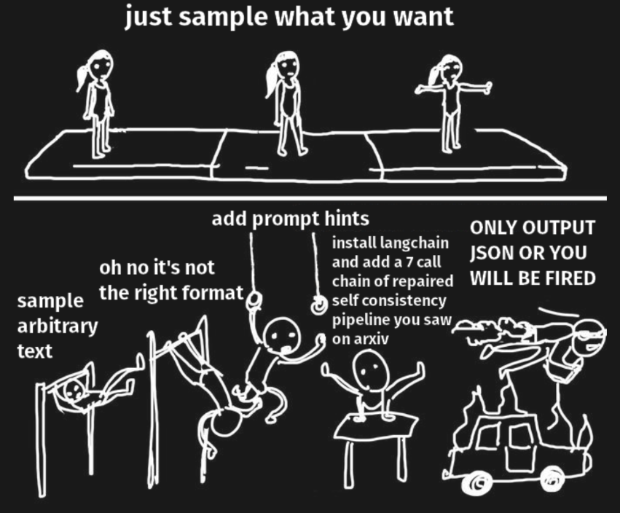
The Prompt Engineering Loop (Before Structured Generation)
1. Write a Prompt: Provide instructions and examples in hopes of guiding the LLM.
2. Run the LLM: Get the output and hope for the best.
3. Inspect the Output: Often, the output isn't quite right:
Wrong format
Extra text
Missing information
4. Tweak the Prompt: Try adding more instructions, rewording, or giving more examples.
5.Repeat Steps 2-4: The cycle continues, often with diminishing returns.

Slide 5
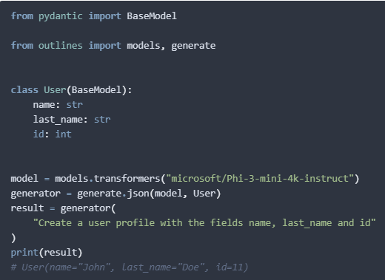
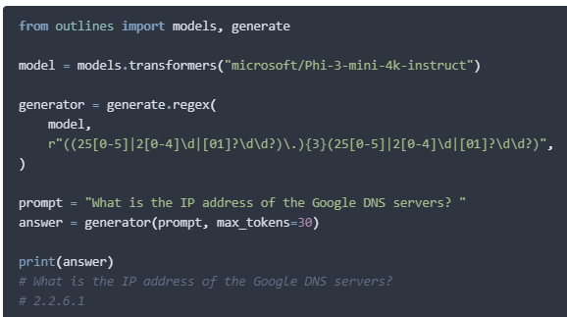
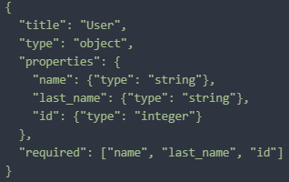
Solution: Structured Generation
Structured generation controls the tokens an LLM samples from to guarantee the output conforms to a predefined structure.
This structure is defined using:
Regular expressions (for simple patterns like email addresses).
JSON Schema (for well-formed JSON with specific fields).
Context-Free Grammars (for complex structures like SQL or programming languages).
JSON / Pydantic
Regex

Slide 6
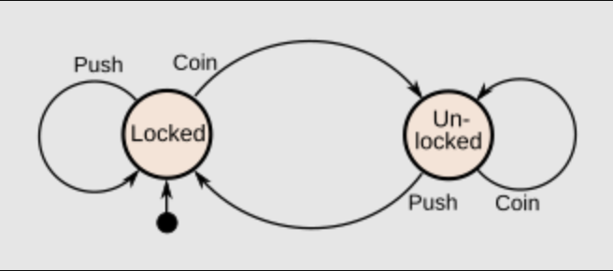
Finite State Machines (FSMs)
FSMs are a powerful tools that can be used for representing and working with structured data.
They consist of:
States: Represent different stages in the structure.
Transitions: Define how to move between states based on input symbols.
Key Idea: Translate structure definitions (regex, JSON Schema, CFG) into FSMs.
A system where particular inputs cause particular changes in state can be represented using finite state machines. This image describes the various states of a turnstile. Inserting a coin into a turnstile will unlock it, and after the turnstile has been pushed, it locks again. Inserting a coin into an unlocked turnstile, or pushing against a locked turnstile will not change its state.

Slide 7
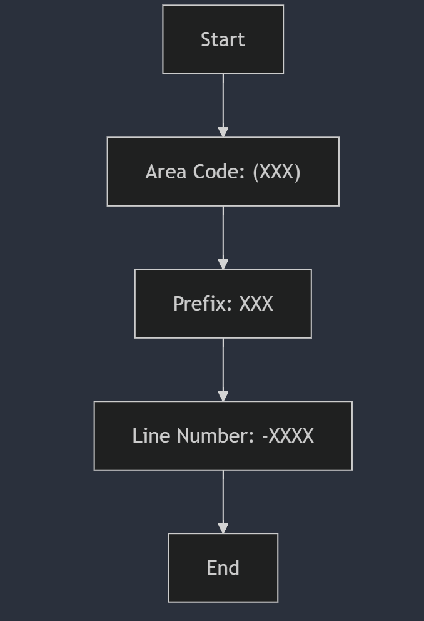
FSMs in Structured Generation
Consider generating a phone number:
(555) 555-5555
An FSM for this structure might have states for:
Area code (555)
Prefix (555)
Line number (5555)
Transitions would dictate the allowed digits at each stage.

Slide 8
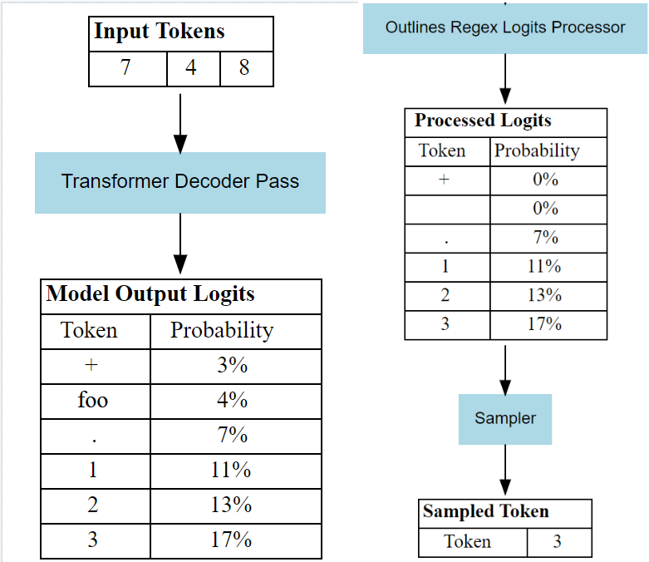
How it works : Token Level Control
1. Prompt the LLM: Provide context and instructions.
2. FSM Guides Generation: The FSM tracks the current state.
3. Restrict Token Choices: Only allow tokens that correspond to valid transitions in the FSM.
4. Sample from Allowed Tokens: The LLM samples the next token, but only from the restricted set.
5. Repeat: Continue until the FSM reaches a final state (complete structure generated).
256-555-748_

Slide 9
Benefits of Structured Generation
Benefits of Structured Generation
Guaranteed Structure: The output will always conform to the desired format.
Improved Performance: By restricting token choices, structured generation leads to better accuracy and fewer errors.
Prompt Efficiency: Structured generation often requires fewer examples in the prompt.
Faster Inference: Can be faster than unstructured generation through optimizations like selective multiplication and coalescence

Slide 10
Structured Generation : Selective Multiplication
In the final layer of an LLM, a large matrix multiplication is performed to convert the internal representation of the text into a probability distribution over the entire vocabulary.
This is computationally expensive, especially when the vocabulary is large. Selective multiplication exploits the fact that in structured generation, we already know many tokens are not allowed. Instead of performing the full matrix multiplication, we only compute scores for the tokens that are actually possible according to the defined structure.
Imagine a scenario where the structure dictates that the next token must be either "name" or "age".
Selective multiplication would only perform the calculations needed to get the scores for these two tokens, ignoring the rest of the vocabulary.

Slide 11
Structured Generation : Coalescence
LLMs use subword tokens, leading to multiple possible paths in the structure's finite-state machine (FSM) that generate the same output string. Each FSM transition requires an expensive LLM call.
Coalescence identifies and merges these redundant paths. It appends the longest matching token (shortest word), skipping unnecessary LLM calls.
Example: Generating the word "name" might involve these paths (and LLM calls):
["n", "ame"] (2 calls)
["na", "me"] (2 calls)
["name"] (1 call)
In our example: Coalescence would directly append "name", reducing 5 potential calls to 1!

Slide 12

A more complex example : Atomic Captioning Pipeline
Goal: Generate a detailed caption for an image that includes multiple levels of information, such as object identification, relationships, attributes, and scene context. Then we want to create both a simple and dense caption using these atomic elements.
Example: An image of a dog chasing a ball in a park. The atomic caption might include:
Entities: Dog, ball, park, grass, trees.
Relationships: The dog is chasing the ball.
Attributes: The dog is brown and white. The ball is red.
Context: It is a sunny day. The park is crowded.

Slide 13
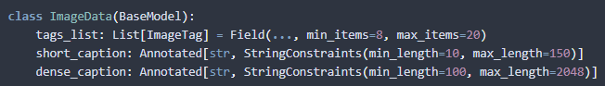
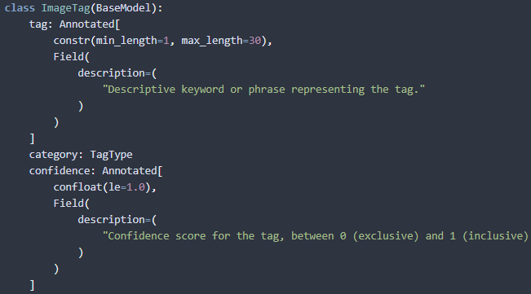
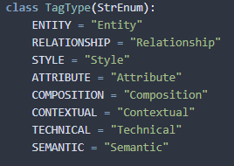
Atomic Caption Pipeline : Structures

Slide 14
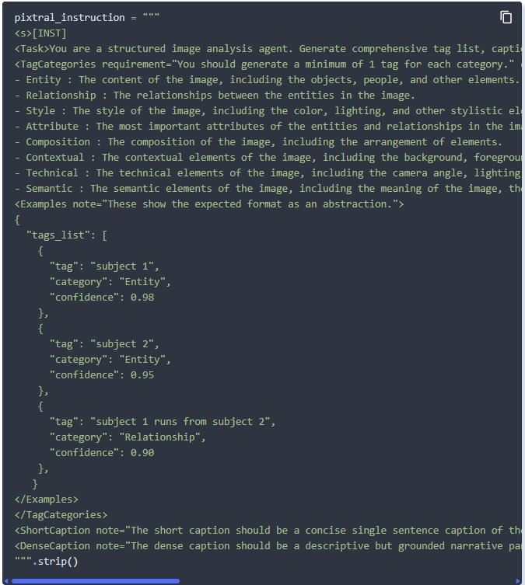
Atomic Caption Pipeline : Instruction
The prompt is still an important part of the structured generation process, however it is now responsible for significantly less and can be focused on driving the content of the response instead of the structure.
Here we focus on giving the llm :
an agent role
details about what we want for each tag category
examples showing a simple graph relationship.
Instructions for what we mean by “Short Caption” and “Dense Caption”

Slide 15
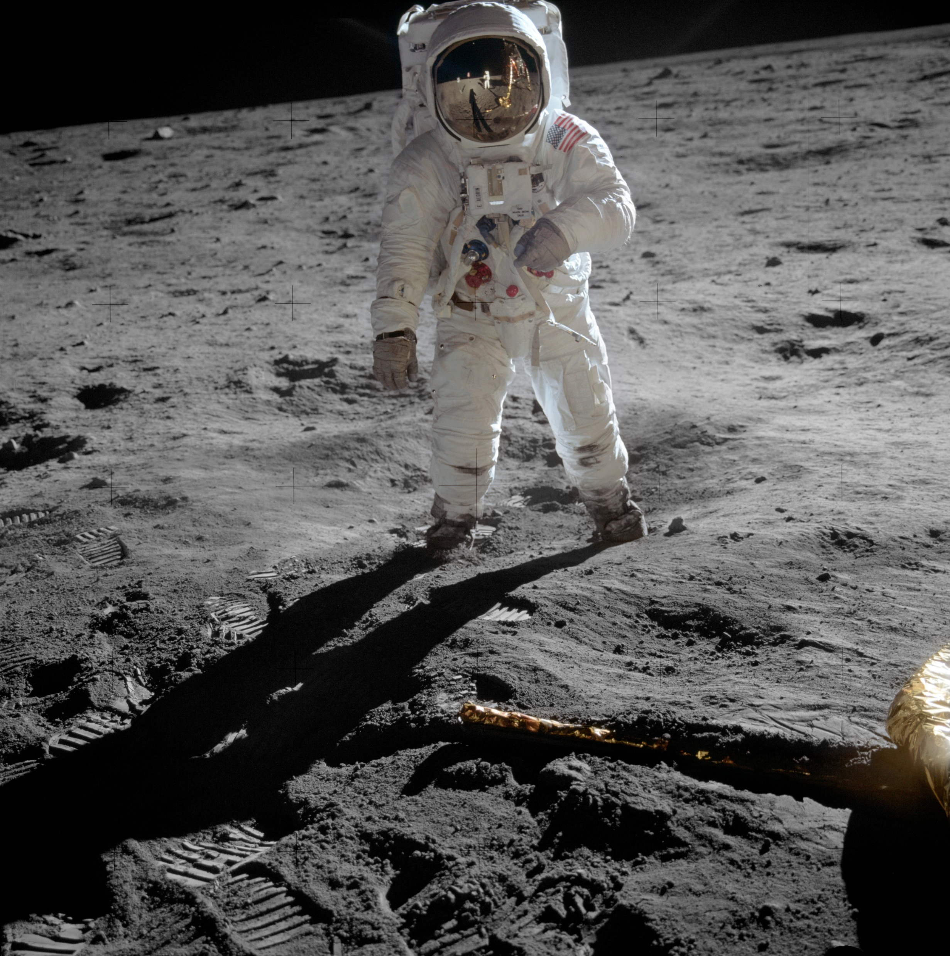
Atomic Caption Pipeline : Result
{'tags_list': [{'tag': 'astronaut',
'category': <TagType.ENTITY: 'Entity'>,
'confidence': 0.99},
{'tag': 'moon', 'category': <TagType.ENTITY: 'Entity'>, 'confidence': 0.98},
{'tag': 'space suit',
'category': <TagType.ATTRIBUTE: 'Attribute'>,
'confidence': 0.97},
{'tag': 'lunar module',
'category': <TagType.ENTITY: 'Entity'>,
'confidence': 0.95},
{'tag': 'shadow of astronaut',
'category': <TagType.COMPOSITION: 'Composition'>,
'confidence': 0.95},
{'tag': 'footprints in moon dust',
'category': <TagType.CONTEXTUAL: 'Contextual'>,
'confidence': 0.93},
{'tag': 'low angle shot',
'category': <TagType.TECHNICAL: 'Technical'>,
'confidence': 0.92},
{'tag': 'human first steps on the moon',
'category': <TagType.SEMANTIC: 'Semantic'>,
'confidence': 0.95}],
'short_caption': 'First man on the Moon',
'dense_caption': "The figure clad in a pristine white space suit, emblazoned with the American flag, stands powerfully on the moon's desolate and rocky surface. The lunar module, a workhorse of space engineering, reflects in the visor, its metallic legs sinking slightly into the dust where footprints and tracks from the mission's journey are clearly visible. The photograph captures the astronaut from a low angle, emphasizing his imposing presence against the desolate lunar backdrop. The stark contrast between the blacks and whiteslicks of lost light and shadow adds dramatic depth to this seminal moment in human achievement."}

